Slide 1



ALY6040: Data Mining Applications
Final Project : Healthcare Employee Attrition Prediction
Prof. Justin Grosz
Group 3
Anukriti Baijal
Nhat Lan Tran
Pooja Kairamkonda
Sakthi Pradeepa Muthukumar

Slide 2
Table of Content
Introduction
Data Cleaning and Methodology
Exploratory Data Analysis
Data Modeling
Conclusion
References

Slide 3

1. Introduction
Employee attrition in the healthcare industry has significant implications for patient care, staff morale, and organizational performance, highlighting the importance of understanding and effectively addressing the factors contributing to employee turnover.
The COVID-19 pandemic has intensified workloads and emotional demands for healthcare workers.
Healthcare workers, particularly in high-stress roles, face challenges such as long hours, heavy workloads, and intense emotional demands.
Our project aims to analyze a healthcare industry dataset and predict attrition using machine learning.
Hypothesis: Determine if factors such as an employee’s age, gender, education, work experience, tenure, salary, and promotion history can influence or help us determine the attrition of an employee.

Slide 4

2. Data Cleaning and Methodology
The dataset consists of 1677 rows of attributes, divided into 35 different columns such as ID, Age, Department, Education Level, Hourly Rate, Job Level/Satisfaction, and more.
Data was cleaned of Missing Values, Duplication, Outliers
Predictor/Outcome variable for classification: ‘Attrition’
Methodology: Quantitative Research Methods with EDA and Data Modeling.

Slide 5
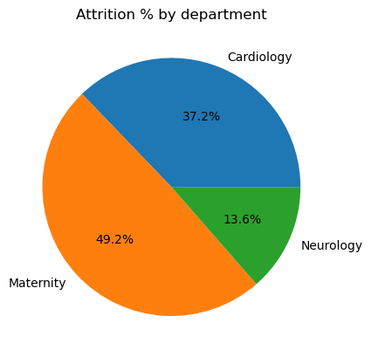
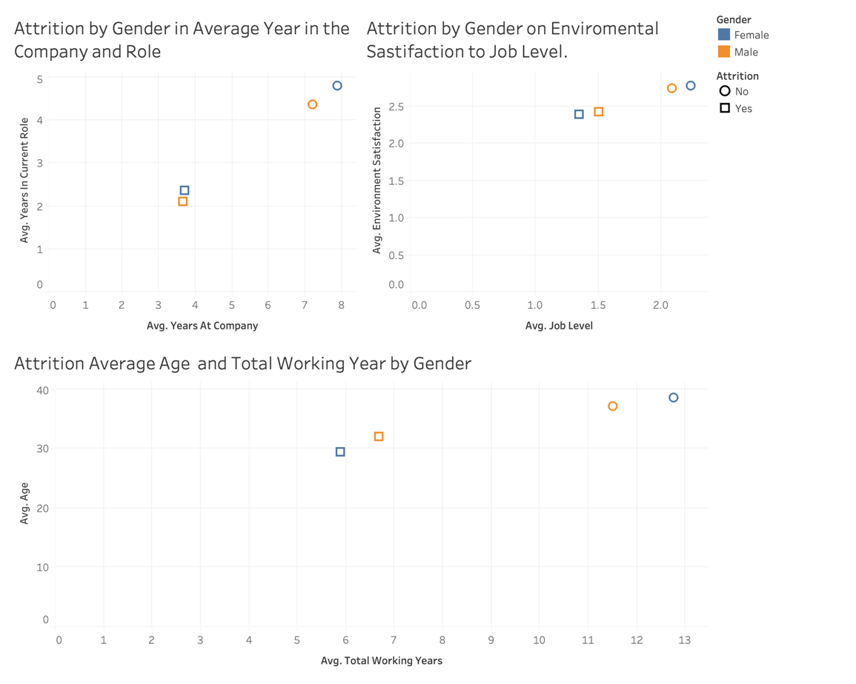
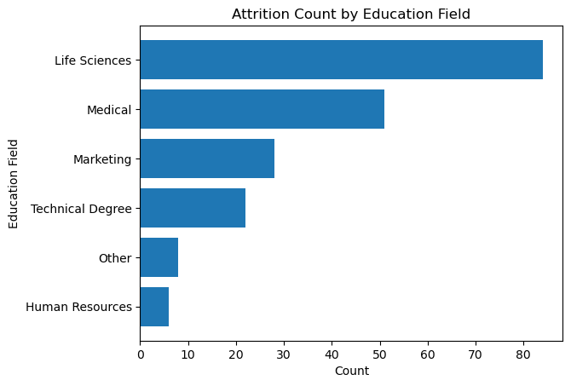
3. Exploratory Data Analysis

Slide 6
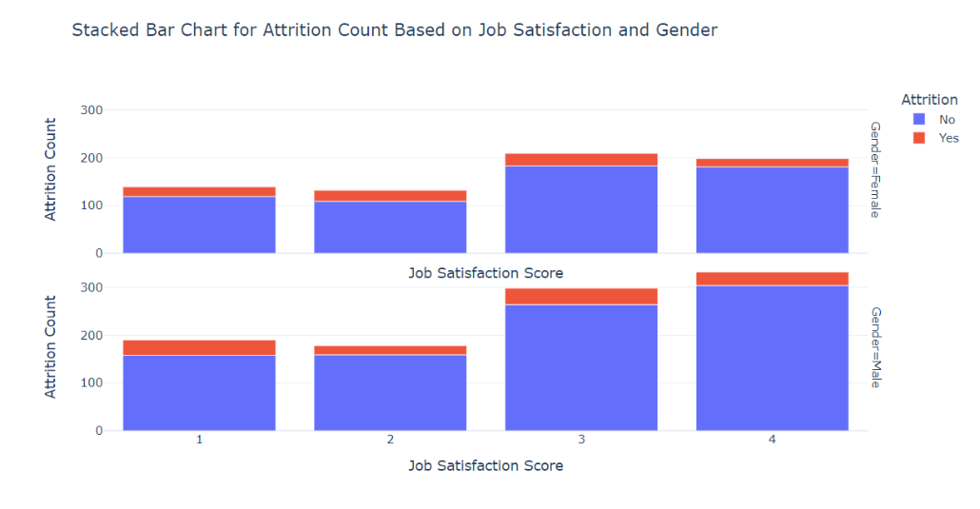
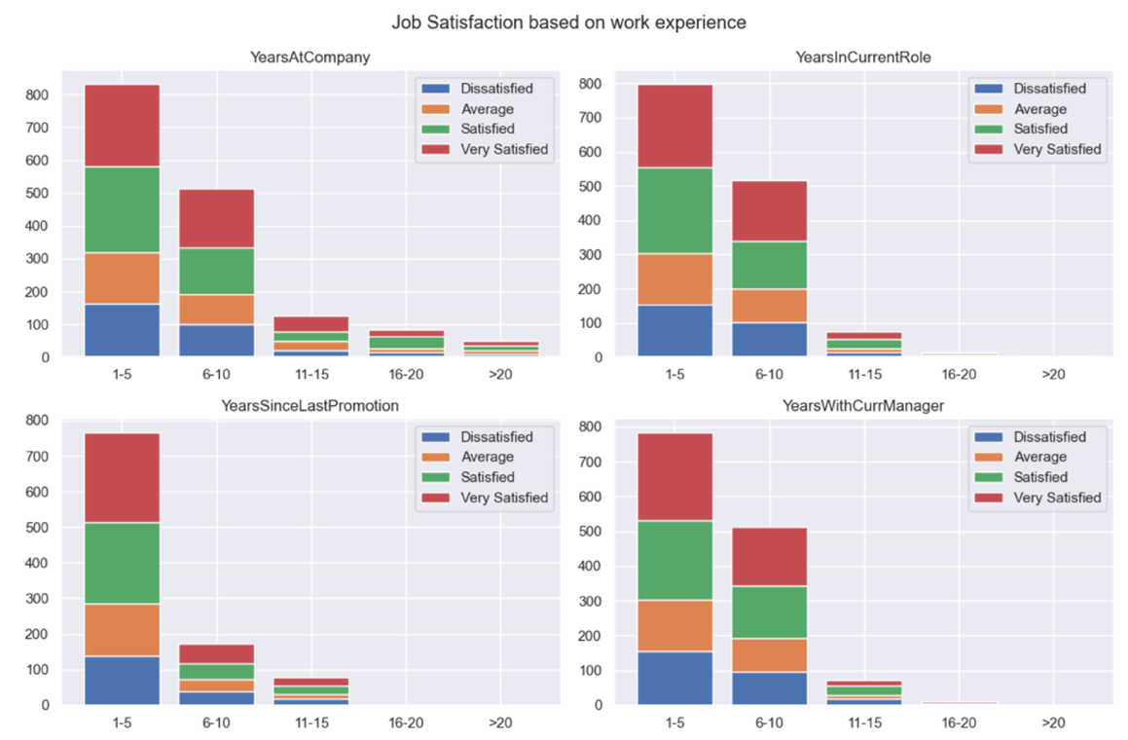
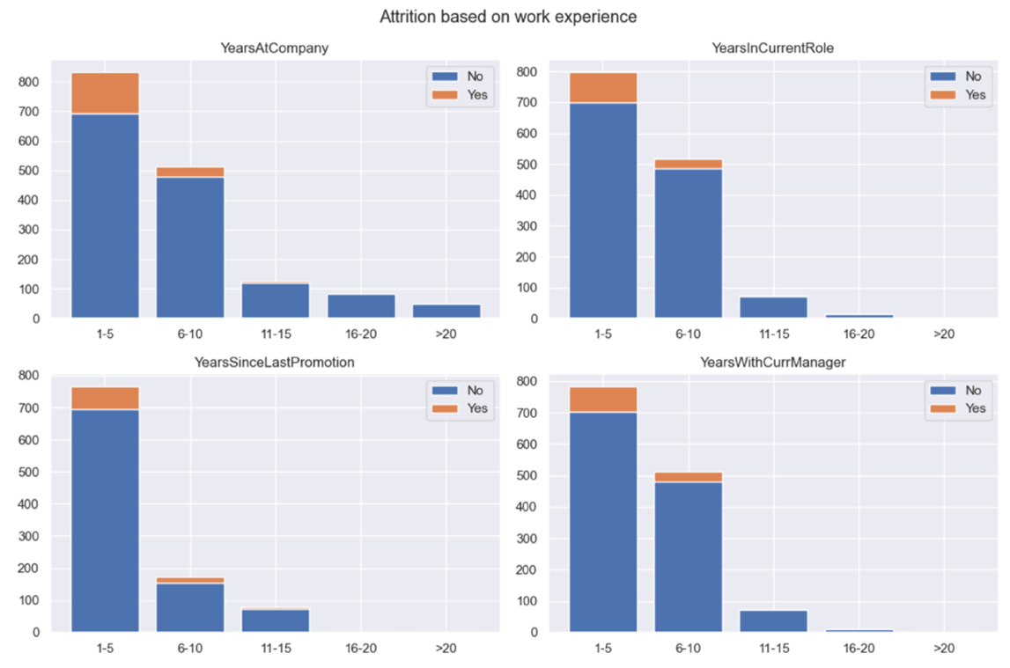

Slide 7
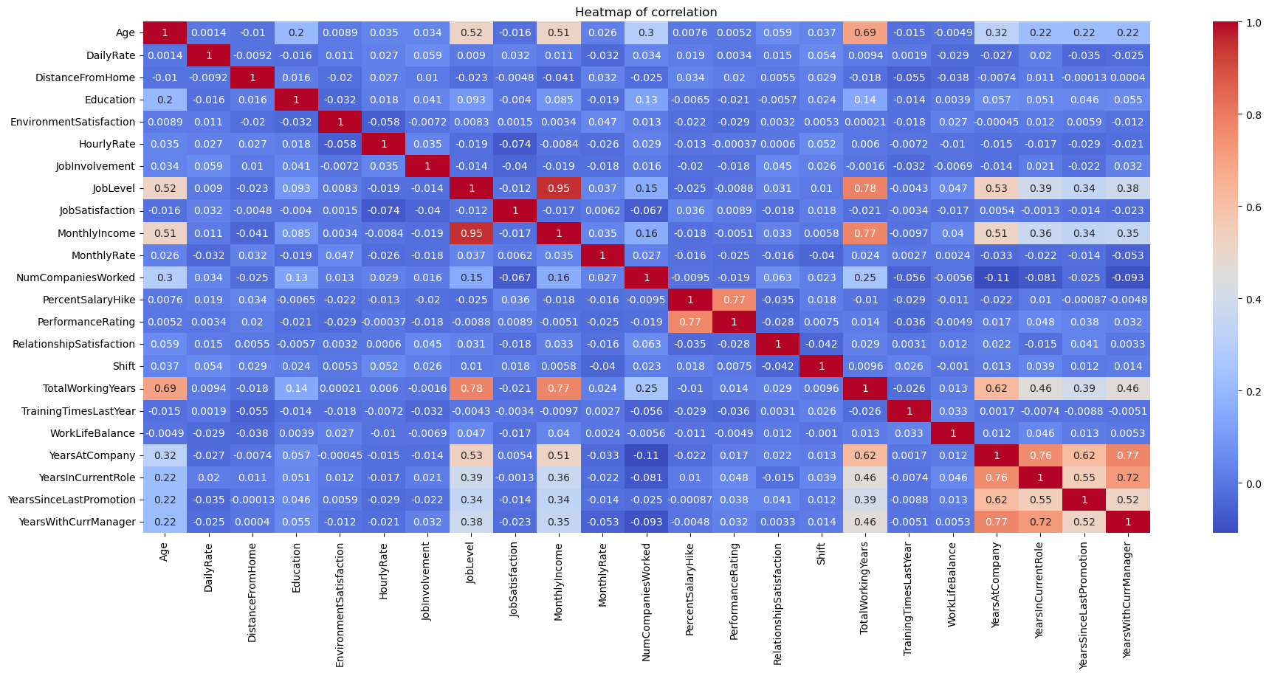
Heatmap of Correlation

Slide 8
4. Data Analysis

Slide 9
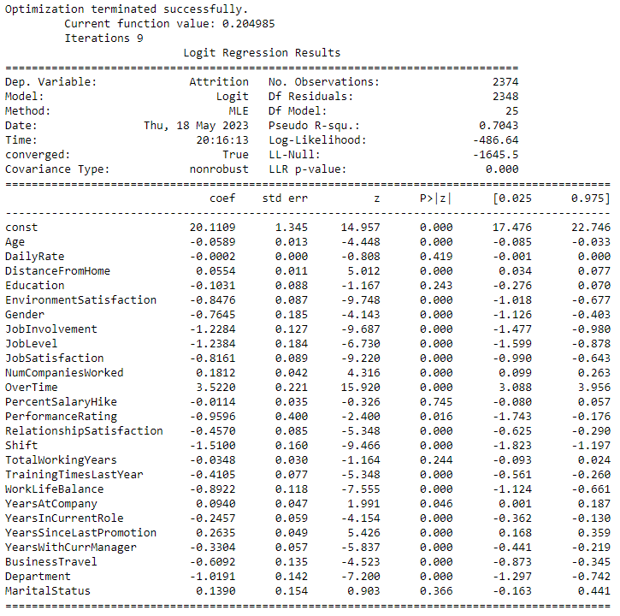

4.1 Logistic Regression

Slide 10
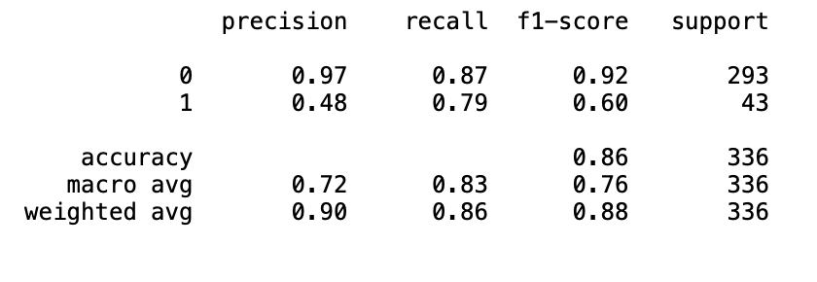
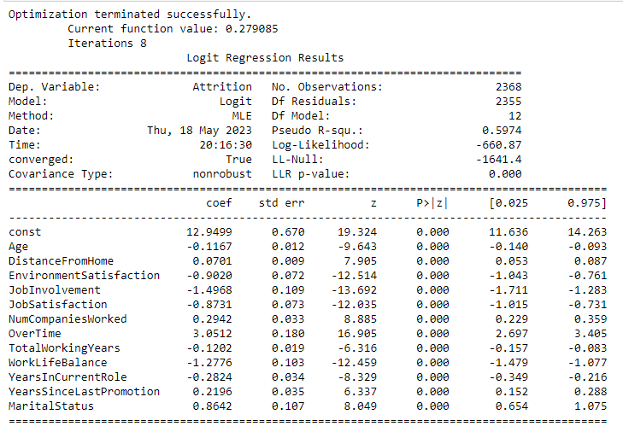
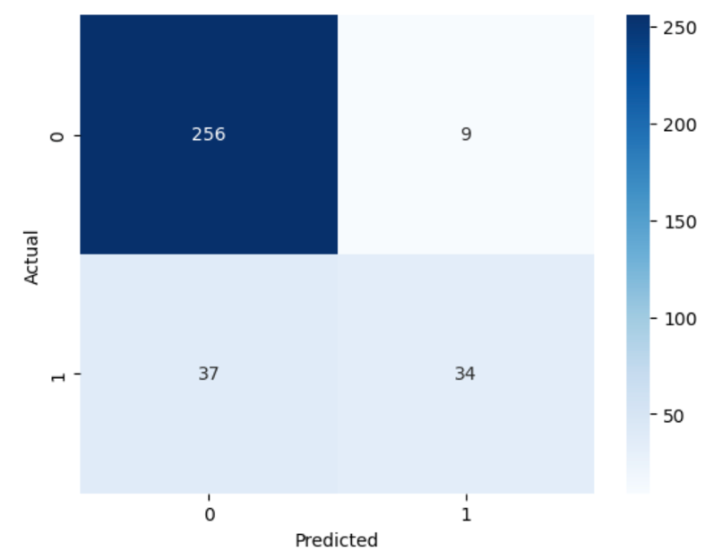
4.1. Logistic Regression – Feature Selection

Slide 11
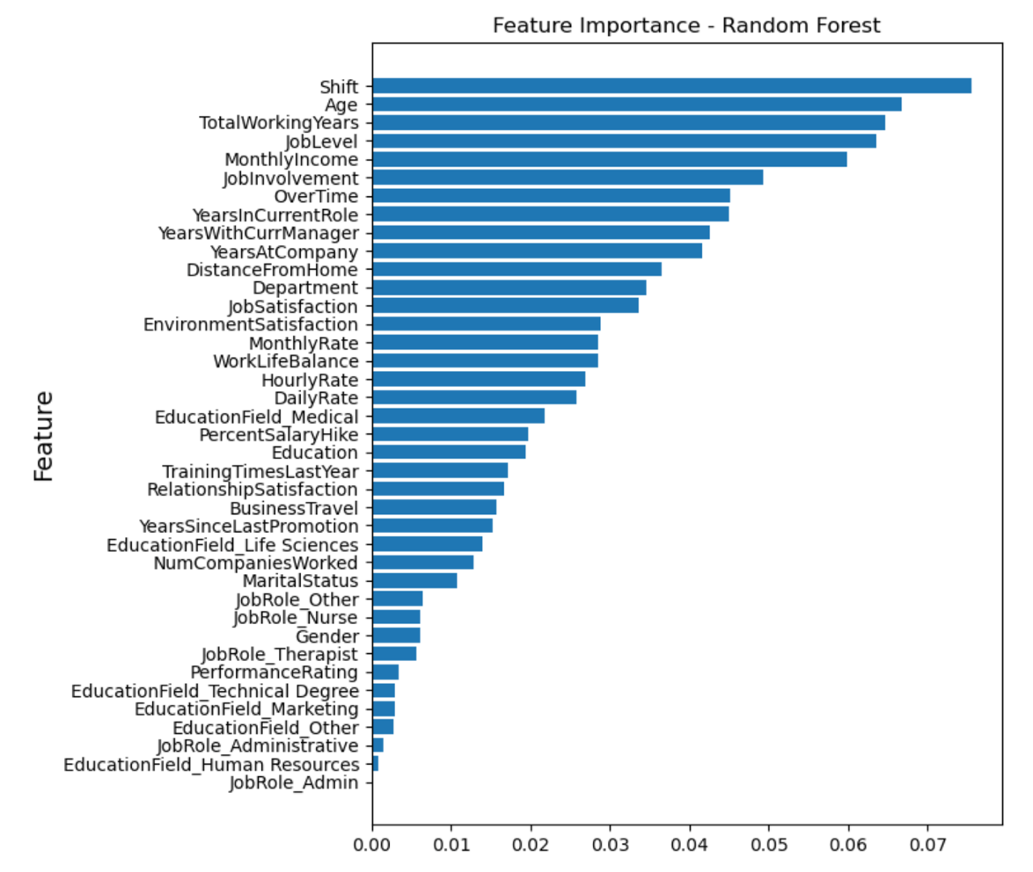
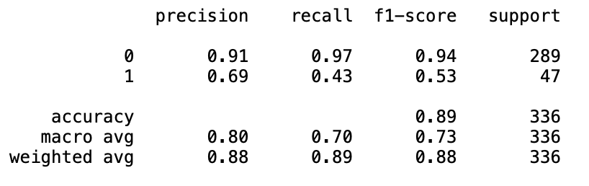
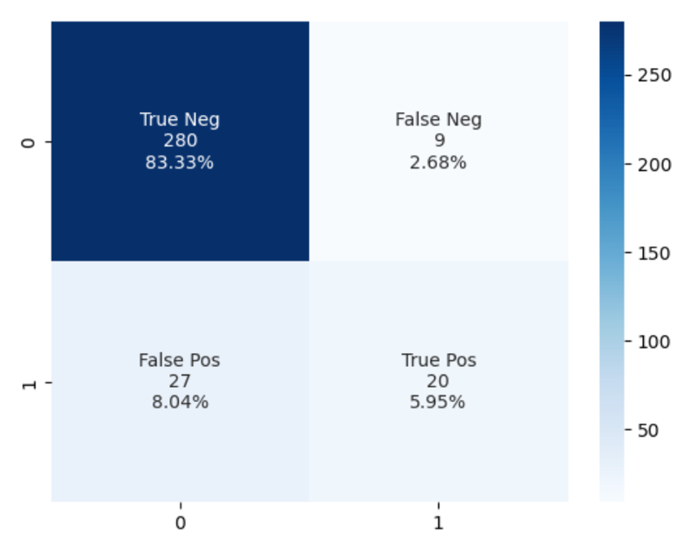
4.2. Random Forest

Slide 12
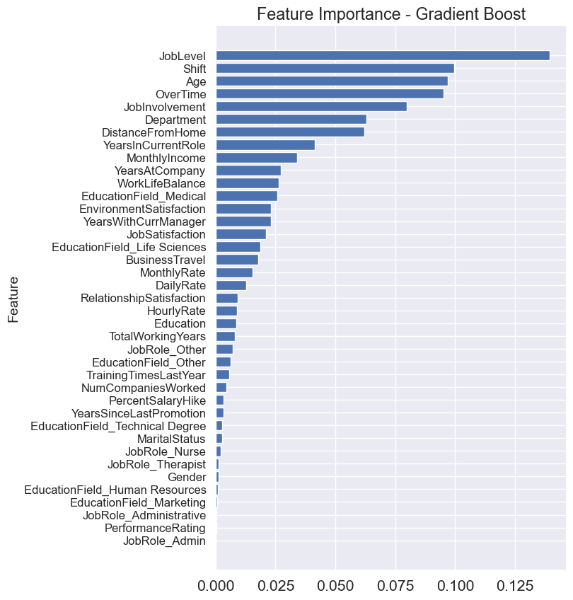
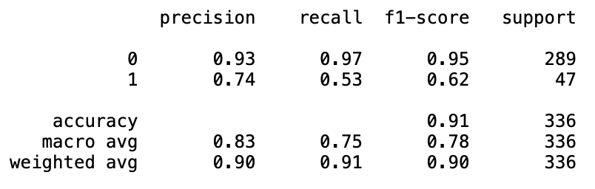
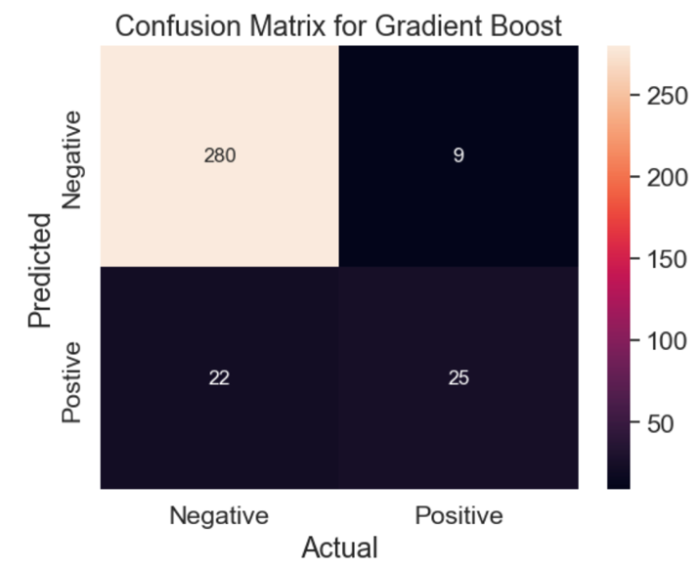
4.3. Gradient Boosting

Slide 13
4.4. Model Comparison and Recommendation
Models | Logistic Regression |  | Random Forest |  | Gradient Boost
Accuracy | 86.30% |  | 89.28% |  | 90.77%
Response Variable | 0 | 1 | 0 | 1 | 0 | 1
Precision | 0.97 | 0.48 | 0.91 | 0.69 | 0.93 | 0.74
Recall | 0.87 | 0.79 | 0.97 | 0.43 | 0.97 | 0.53
F1-Score | 0.92 | 0.60 | 0.94 | 0.53 | 0.95 | 0.62
The recommended model for the company is the Gradient Boost, which handles imbalanced datasets better and can capture non-linear relationships between variables.
By applying the SMOTE technique and training the re-sampled data on the Gradient Boosting model, biased results are further mitigated.

Slide 14
5. Conclusion
Conducted data analysis using Python and Tableau on employee attrition data in a healthcare organization.
Identified key factors influencing attrition and built predictive models to predict employee attrition as 'Yes' or 'No’.
Developed Gradient Boost model which achieved higher accuracy and lower false positives/negatives compared to other models (Logistic Regression and Random Forest).
Significant variables impacting attrition include age, overtime, job involvement, distance from home, work-life balance, and monthly income were identified.
Proposed focusing on employees likely to stay and prioritizing resources based on model insights for effective retention strategies.
Recommended targeted measures for employee retention, such as implementing recognition programs, addressing burnout, and promoting employee well-being.

Slide 15
6. References
[1] John, M. (February 15, 2023). Employee Attrition for Healthcare. Retrieved on April 14, 2023, from https://www.kaggle.com/datasets/jpmiller/employee-attrition-for-healthcare?resource=download
[2] Pierre, S. (September 2, 2022). Analyzing Employee Attrition in Healthcare Data and Predicting Outcomes. Retrieved on April 14, 2023, from https://towardsdatascience.com/analyzing-employee-attrition-in-healthcare-data-and-predicting-outcomes-9afe822dcee
[3] Singh, A. (July 6, 2020). Exploratory Data Analysis — Employee Attrition Rate. Retrieved on April 14, 2023, from https://medium.com/swlh/exploratory-data-analysis-employee-attrition-rate-591ce8e7518f
[4] Killham, E. (January 25, 2022). Employee Attrition Analytics: The Who, When & Why of Employee Turnover. Retrieved on April 14, 2023, from https://blog.perceptyx.com/employee-attrition-analytics
[5] Mahendru, Khyati (2019, June 24). How to Deal with Imbalanced Data Using SMOTE. Medium. Retrieved from: https://medium.com/analytics-vidhya/balance-your-data-using-smote-98e4d79fcddb

